Slide 1



EDA – PMO

Slide 6
PMO
You have recently joined the Prime Minister's Office under the leadership of a Senior Data Officer as a Data Analyst. You have been assigned the following task to help the Prime Minister take a few decisions.

Slide 7
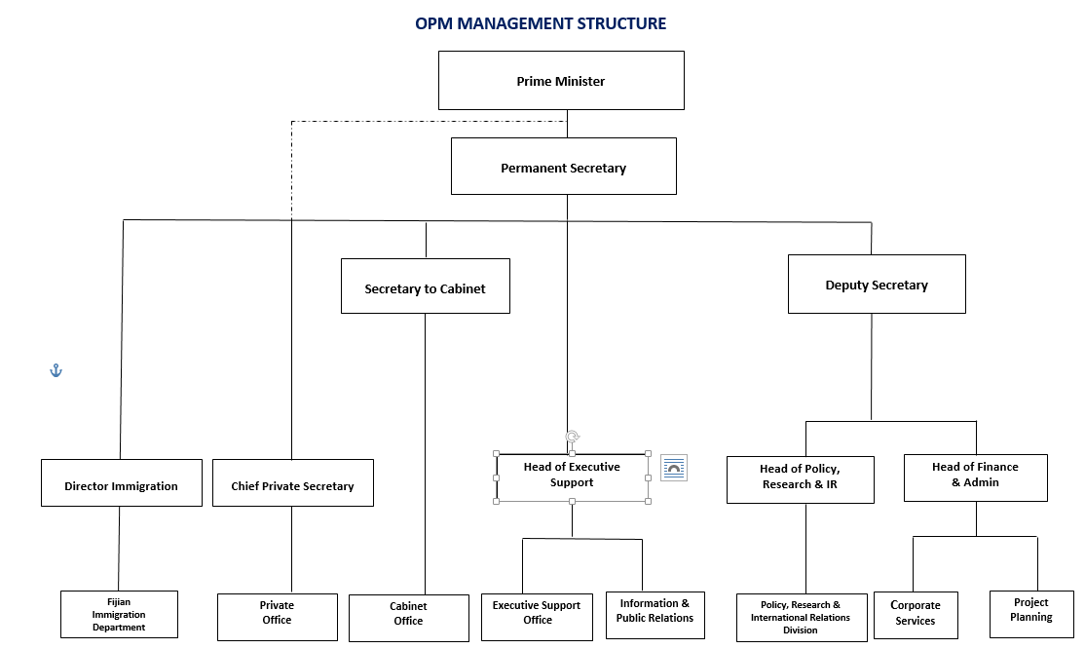
PMO

Slide 8
Problem Statement:
Prime Minister Narendra Damodar Das Modi has recently joined his second innings at the PMO and now he is looking to take some crucial decisions regarding improving various Infrastructure and Services across all states.
Prime Minister has asked the Senior Data Officer to analyze the data for various States across various sectors to find out where the improvement is needed to be made and what all states are already doing great in providing services and infrastructure to their citizens.
Since there are a lot of sectors and services, the chief data officer has assigned you with two most important sectors.
Roads
Electricity Generation

Slide 9
Data:
To download the data, follow the following steps:
Visit https://www.niti.gov.in/state-statistics
Scroll down to the Infrastructure section
Download the data for Roads and Electricity Generation

Slide 10
Areas of Analysis:
Electricity Generation
Find the top 3 states according to the total electricity generated by them between the years 2006 to 2016(including both)
Once you find out the top 3 states according to the total electricity generated by them, use the following PDF file and look at the Renewable Energy Potential of these top states.
Analyze their solar potential.
Grid Connected Solar Projects
Rooftop Systems Capacity Commissioned
Solar PV Pumps Installed

Slide 11
Perform a similar analysis for Wind.
Estimate the total investments made by them towards renewable energy project implementations.
Look at the yearly power generation for the top 3 states, do you find any pattern? Write your observations.
Analyze the power generation pattern for the capital Delhi. Do you find any pattern?
Filter the data for Union Territories and perform a similar analysis as done for the top-3 states.

Slide 12

Roads:
Find the top 3 states according to the total KMs of road constructed.
National Highways
State Highways
PWD Roads
Urban Roads
Project Roads
Rural Roads

Slide 13
Create a new dataframe with the following columns:
Using the above table find the top states that constructed maximum road per person in their state.
State Name | Total Urban Road | Total Rural Road | Total | Population as on 2013

Slide 14
Results:
Present your result in a business presentation and record a video explaining your analysis to the CEOs of the company and your suggestions to them.

Slide 15
Important Notes:
Please note that since this is an EDA Case Study, your analysis should not be just limited to the questions asked above. You are required to take extra steps in order to find out more interesting insights from the data.
If you are generating plots, please make sure that you have also added the inference that you may derive from the plot. Any plot generated without your observation/inference will not be considered for evaluation.
Add details regarding any assumptions that you make while working on the case study. You are free to make assumptions or add more insights to the analysis by adding data from various sources but any such steps taken by you need to be mentioned in your solution file.

